Slide 1
Bedrock Business Utility
A public identity utility supported by LF Governance Networks, Inc.
Bedrock Consortium Governance Framework Working Group

Slide 2
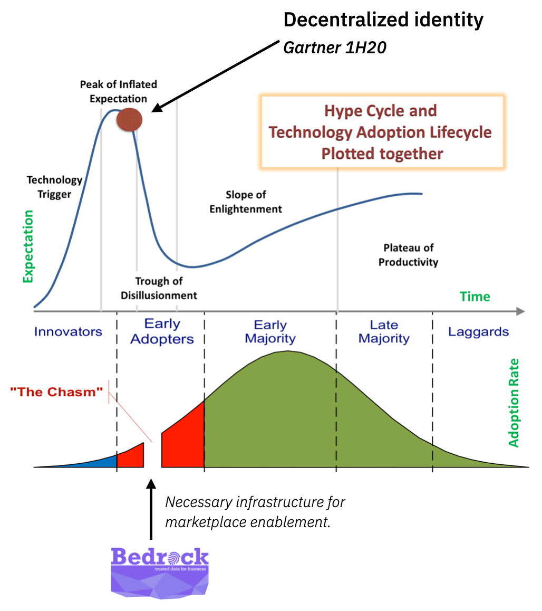
Verify
Prospective Member Briefing
Agenda Topics
Issuer
Why should I care?
What is a public identity utility?
What is BBU?
Why is BBU needed?
What is the BBU Business Model?
What are the BBU Membership Options?
How is the BBU organized?
How to join?

Slide 3
Why should I care?
Why is identity so problematic?
What is the solution?
What will it take to solve?
Should you act or wait?

Slide 4

Our Identity is Broken
The pain associated with proving things about us is all too familiar:
24 hours to onboard a doctor
Causes 40,000 lost clinical days in the UK
6 minutes to verify a caller
Knowledge-based authentication is slow, insecure & expensive
23 fields of information to complete a purchase
Friction, abandonment, over-sharing of personal data
100s of passwords for business and personal accounts
Leads to re-use, poor security

Slide 5

Failing Legacy Approaches
Today’s solutions have serious shortcomings.
Siloed IAM platforms
Centralizing control and data moves friction to the boundaries
Repetitive, manual processes
Inefficient and often inaccurate
Check-the-box compliance solutions
Rarely addresses the problem at its source

Slide 6

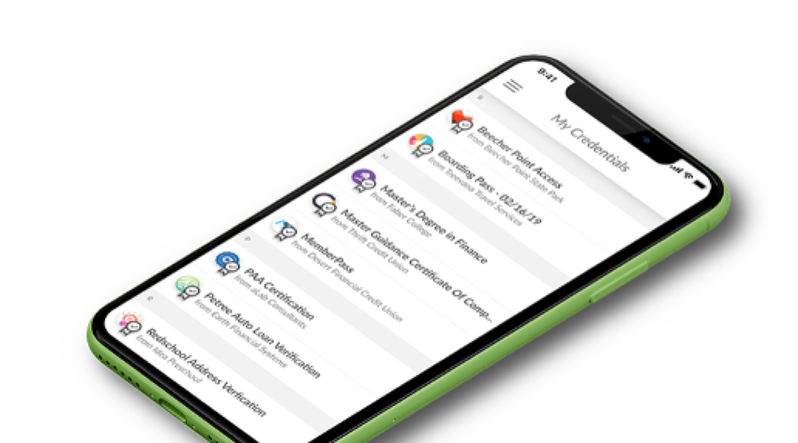
Solution: Portable Digital IDs
Equip individuals & organizations with secure verifiable credentials:
24 hours → 5 minutes to onboard a doctor
Enabling fast, secure mobility of healthcare providers between clinical settings
6 minutes → 6 seconds to verify a caller
Greater customer satisfaction & more efficient use of call center resources
23 fields of information → 1 tap to complete a purchase
Driving sales, loyalty & convenience
100s of passwords → 1 device for business and personal accounts
Keep credentials & personal data securely under your own control

Slide 7
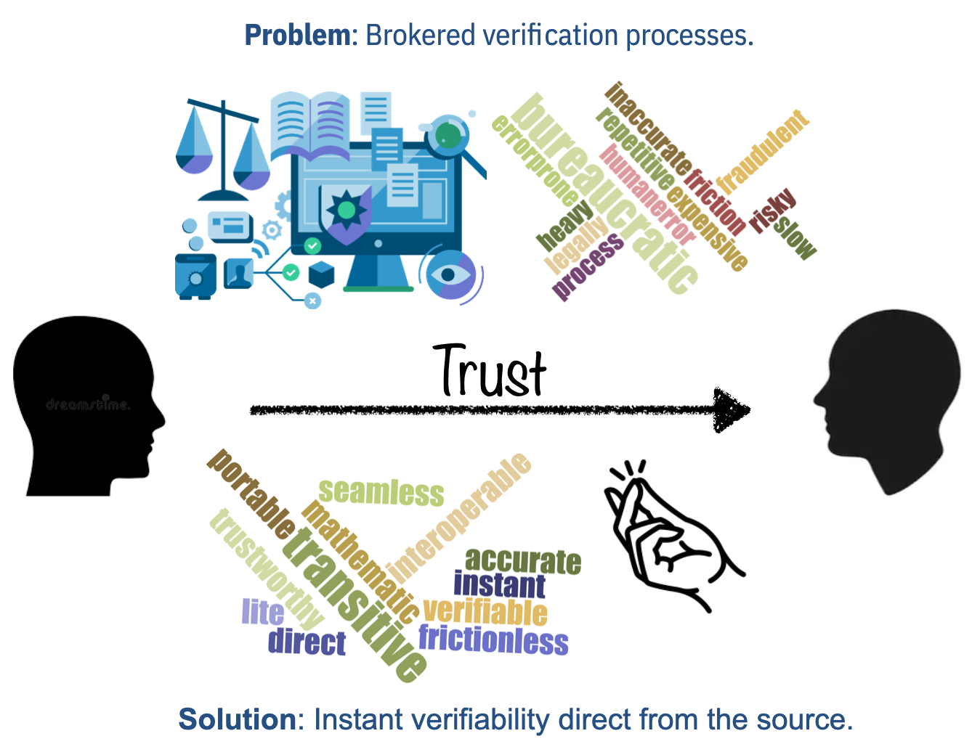
How? Improved Verifiability
Moving from a brokered verification process to a direct verification process.
Transition: Decentralized identity infrastructure leads to portable digital IDs.
New Approach: Verifiability using Transitive Trust where digitally signed statements from outside parties can be instantly verified mathematically.

Slide 8
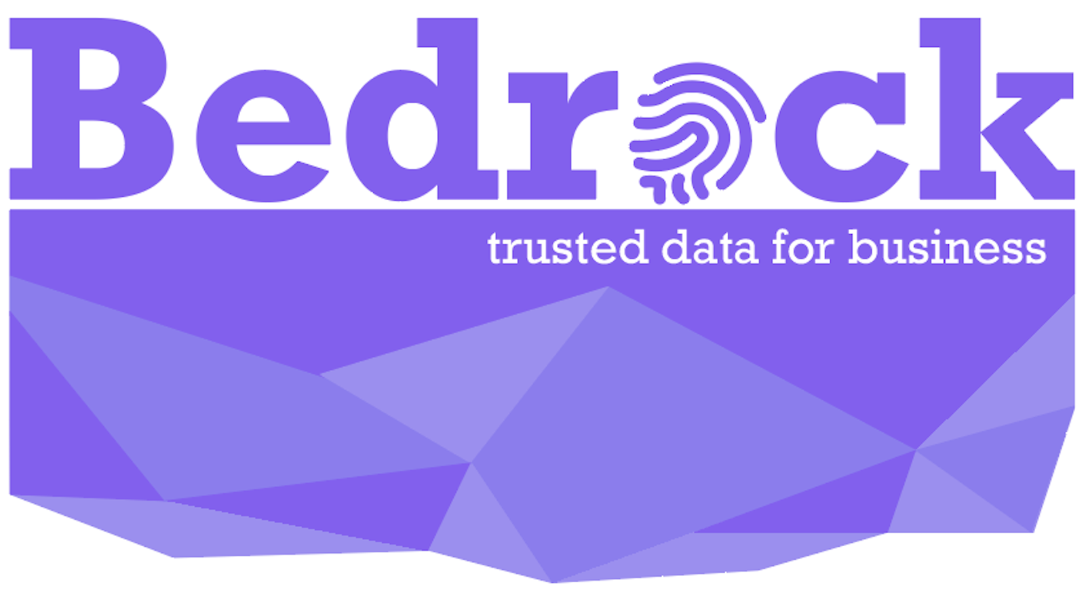
What is under the hood?
The industry has built a set of open technologies to support the next-generation of interoperable and standards-based identity infrastructure.
Open technology that supports:
Secure & tamper-proof
Instantly verifiable
Controlled by the user
Improved privacy
17,000+ contributions from 150+ developers and 90+ organizations
Decentralized Infrastructure
Public Identity Utilities

Slide 9
Why now?
Personal data has gone from asset to liability.
Privacy is hot
Contactless interactions (identity, payments) stemming from hygiene factor
Regulation is a requirement
Compliance costs $150Bn in the US, and enforcement has barely begun
IAM solutions underpin digital transformation
Spend almost doubling to $38Bn by 2023
Business need to mitigate risk exposures associated with Centralized IAM approaches
7.9Bn records breached in 2019

Slide 10
Innovator v. Laggard
The industry trend toward decentralized identity is underway. How will you act?
Collaborate | Do Nothing
Help bootstrap marketplace through collaboration on an initial network; open learning Eliminates the time and expense of establishing a private network Positions businesses to offer additional products and services to customers now Reach new customers segments Validate regulatory privacy compliance trends Improved KYC processing in a manner that reduces the reliance on 3rd party verification services | Convene or build you own Public Identity Utility Risk: starting from scratch is Hard, Timely, and requires gathering interested parties because decentralized identity is a team (collaborative) effort. Pay-as-you-go! Risk: Pay other utilities for which you will have no say in the governance model or pricing impact to your business

Slide 11
Public Identity Utilities
How are entities discoverable?
How do entities become verifiable?
What influences business models?

Slide 12

How do entities become discoverable?
Lookup and verification business models continue to improve.
Pay to be listed.
Phone #
Advertisement
Pay to be listed.
DID
DID Document of Services and Public Keys
People, Organizations, Businesses
Pay to be listed.
Domain Name
Advertisement
DID Document
Identity Utility Network
(DID Ledger)
THEN
NOW
TOMMOROW

Slide 13
What are the basic concepts of a Public Identity Utility?
Some introductory terms and concepts.
Decentralized identifiers (DID): A W3C Specification for unique identifiers.
Schema: A set of attribute data types and formats that can be part of a credential claim. Eg., the fields within a passport/license document.
Credential Definition: A public statement by the issuer that they will publish credentials agains a specific schema(s).
Credential: An issuer-specific data fields that can come from one/more schemas and defines the proofs sent by the holder. Eg., proof of education, age, nationality, etc.
Verifiable Credential (vCred): A W3C Specification for Verifiable Credentials.
Revocation List: A registry that helps identify the revocation of a private DID of a holder
DID v. Verifiable Credential: DIDs create the cryptographic trust between two entities whereas the verifiable credential creates the business trust across the same.

Slide 14
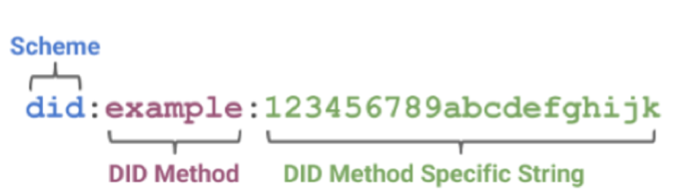
How do entities become verifiable?
A minimal set of non-personal meta-data is stored on the ledger.
DID Document
Each write to the ledger will pertain to a set of specific transaction types that may be accompanied by different fee values.

Slide 15
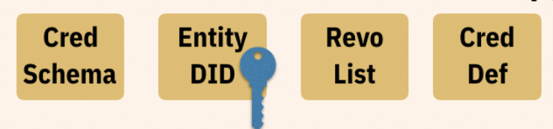

Utility Interactions: Sample issuer transactions
An issuer is responsible for several types of write transactions to a public identity utility.
Utility A
Utility B
2
1
3
4
Challenge
Examiner
Issuer
Holder
Verifier
Attest
Issue
Present
SOR
SOR
Publishing a DID Document containing at least one public key and possibly several service URLS. The DID Document is associated with a Public DID.
Publishing a Credential Schema.
Publishing a Credential-Definition that allows an Issuer to associate their DID with a specific Credential Schema.
Publishing a list of revoked credentials.
NOTE: Public DIDs are written to the public Utility whereas private DIDs are maintained off-ledger.

Slide 16
Utility Interactions: Sample verifier transactions
A verifier is responsible for several types of write and read transactions to one or more public identity utilities.
Utility A [did:aaa]
Utility B [did:bbb]
2
5
4
3
1
Challenge
Examiner
Issuer
Holder
Verifier
Attest
Issue
Present
SOR
SOR
did:aaa rooted cred-def
Publishing a DID Document containing at least one public key and possibly several service URLS. The DID Document is associated with a Public DID.
Process presented credential. Locate Utility associated with DID Root Namespace and validate Cred-Def. Fail verification process if does not exist.
Check if Credential is on Revocation List. Fail verification process if true.
Validate the existence of Issuer DID corresponding to Cred-Def. Fail verification process if not valid.
Validate the existence of Credential Schema corresponding to Cred-Def. Fail verification process if not valid.

Slide 17

What factors impact an identity utility business model?
Public Identity Utilities have specific income and expense characteristics that are addressed by the principles, polices and procedures outlined in their governance frameworks.
Expenses
Node Hosting
Network Operation and Maintenance Services
Consortium Governance
Software Maintenance
Income
Consortium Membership
Community Donations
Transaction Revenue
Members and/or Donors
5
Identity Utility
Acme
4
Transaction Authors
Governing Body
6
1
Identity Utility
Service Provider
2
3

Slide 18
Bedrock Business Utility
(BBU)
Who is the Bedrock Consortium?
What is the BBU?
What are goals of the Governance Framework?

Slide 19






Bedrock Consortium
A participant organization in the digital trust marketplace influenced by the ToIP Foundation.
A collection of international private sector companies that operate the Bedrock Business Utility
Comprised of companies that:
desire to participate in digital trust ecosystems
share a common interest in collaborating on the delivery of the infrastructure and governance necessary for a dedicated and trusted public identity utility based on decentralized identity technology.

Slide 20
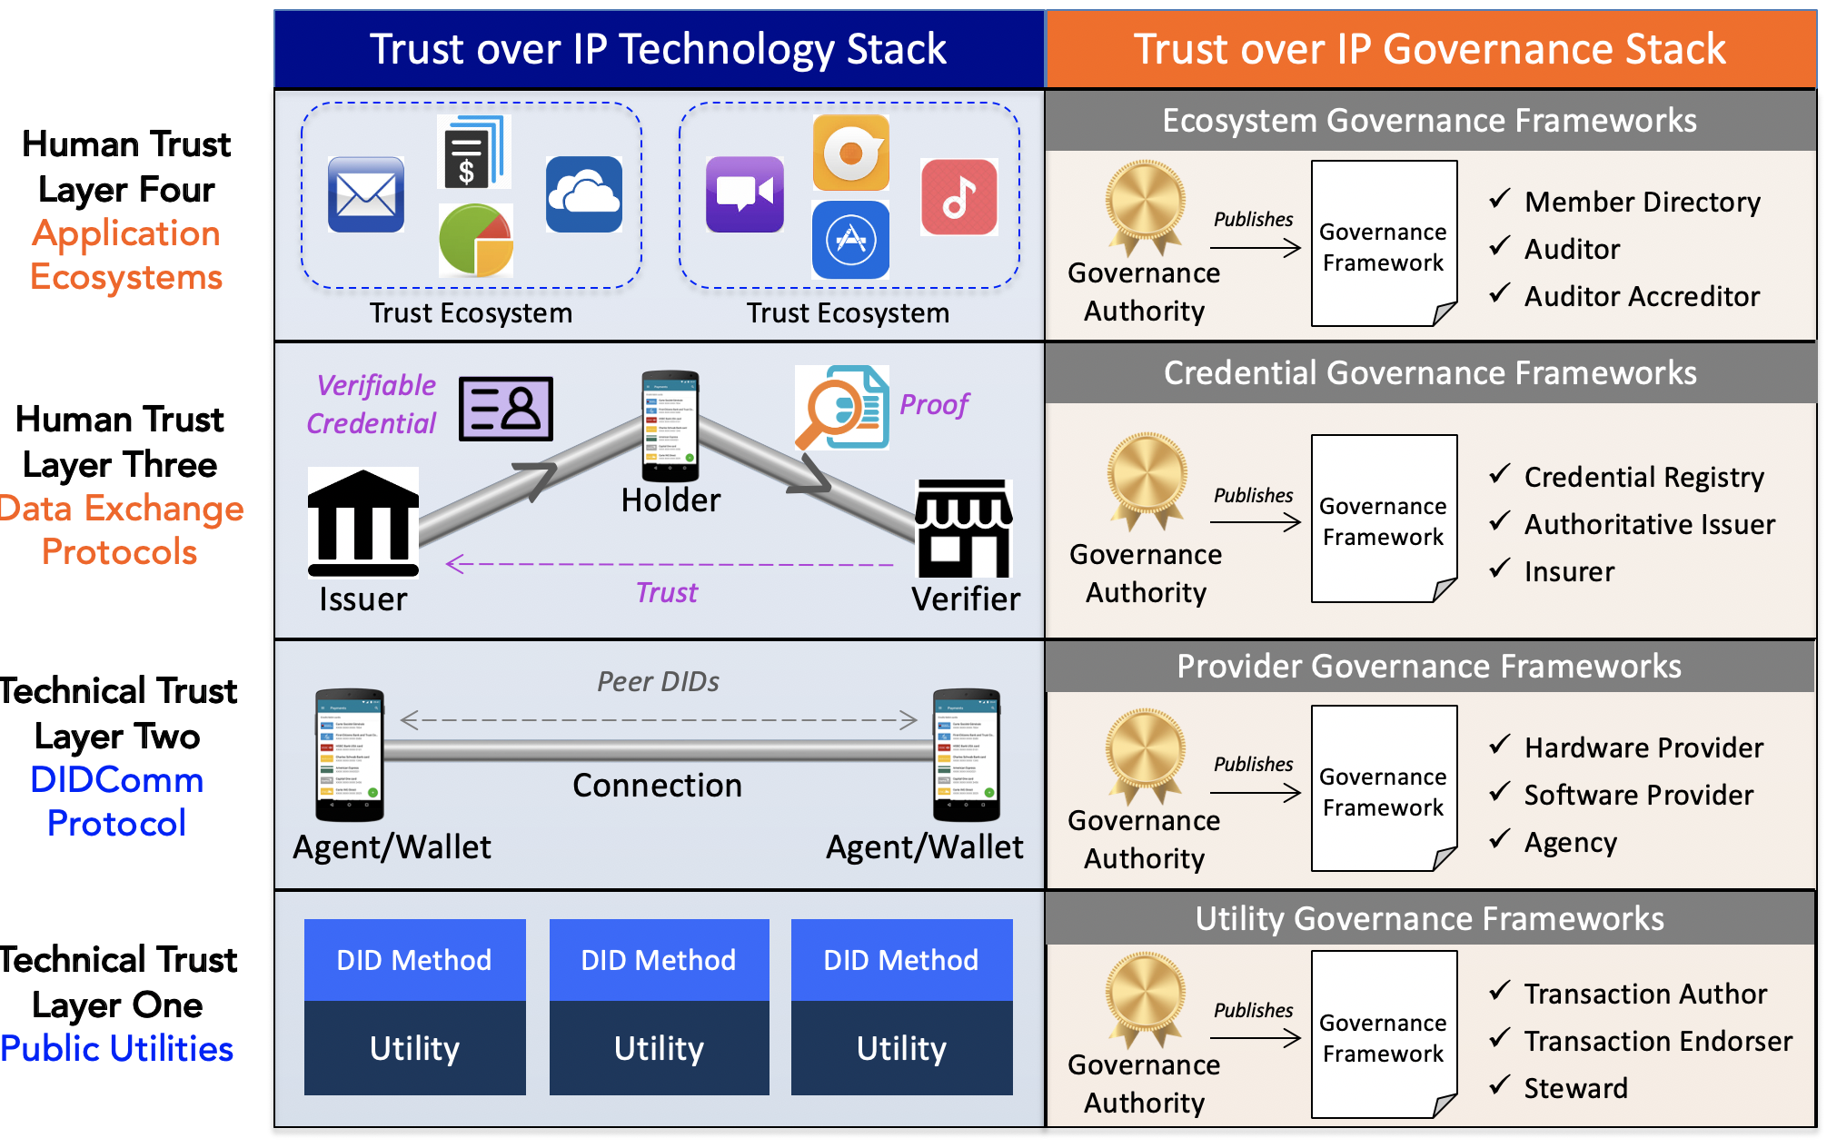

Bedrock Business Utility
An instance of a public identity utility.
ToIP Foundation
An independent self-governed and self-sustainable public identity verification service.
Supported by the Bedrock Consortium and enabled by the LF Governance Networks, Inc. (a non-profit legal entity).
Intended to reliably serve the verifiability of both physical and online digital identity interactions.
Layer 1
Ecosystem Foundry
Working Group
Utility Foundry
Working Group
Advise
DID Utility
Bedrock
did:bbu
Governing Board

Slide 21
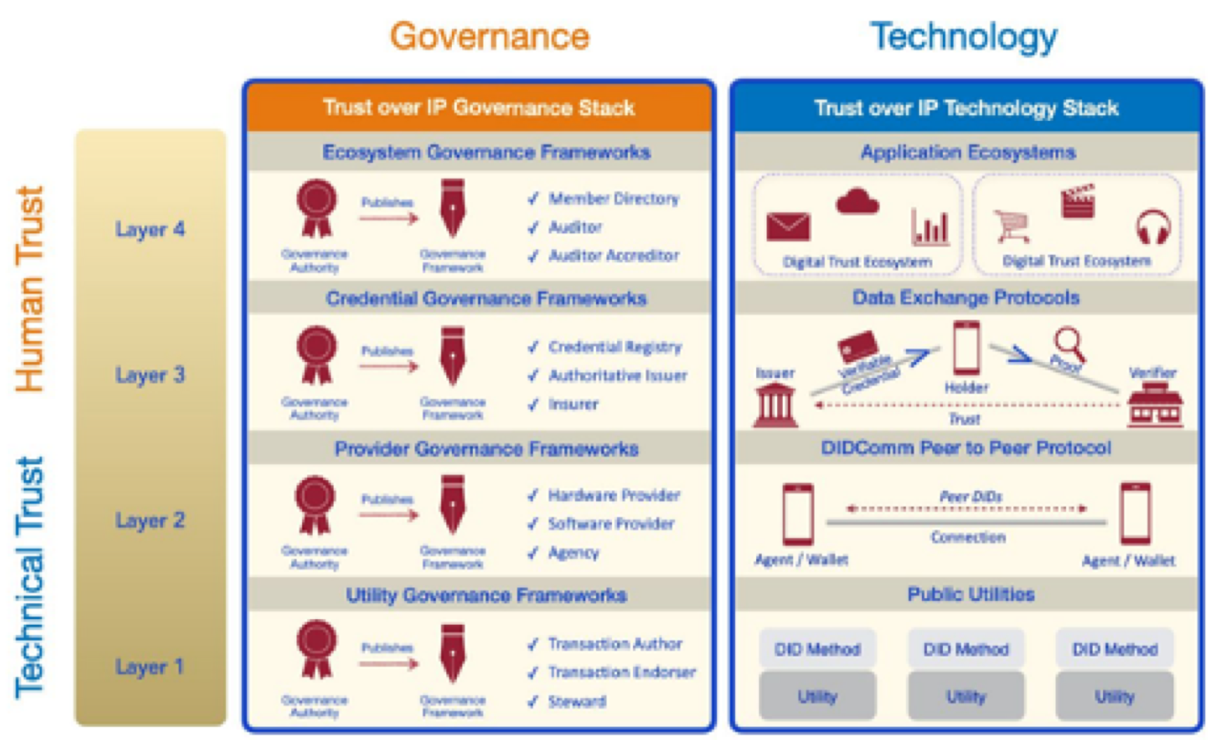
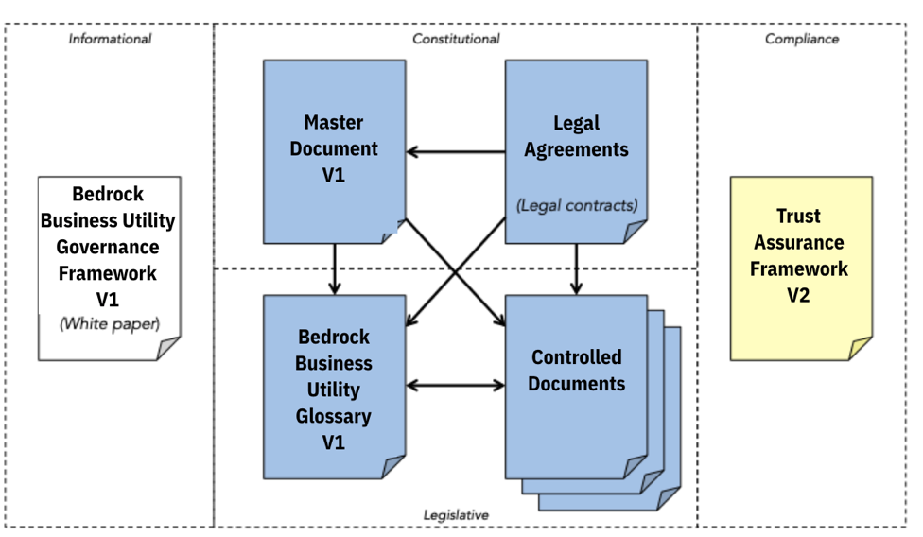
Governance Framework
A compendium of informational, constitutional and compliance oriented documents used to govern a Layer 1 Public Identity Utility
Enforces permissioned-writes with contractual instruments that will conform to privacy regulations such as GDPR.
Maintains financial sustainability of the consortium members without the use of cryptographic tokens.
Establishes a governing board so that no single organization owns the identity utility.
Adheres to specific open standards and protocols. As an example, the BBU will use Hyperledger Indy.

Slide 22
Legal Entity Model
What LF Legal Entity Structure?
What is BBU affiliation with ToIP Foundation?
What contractual instruments are required?

Slide 23
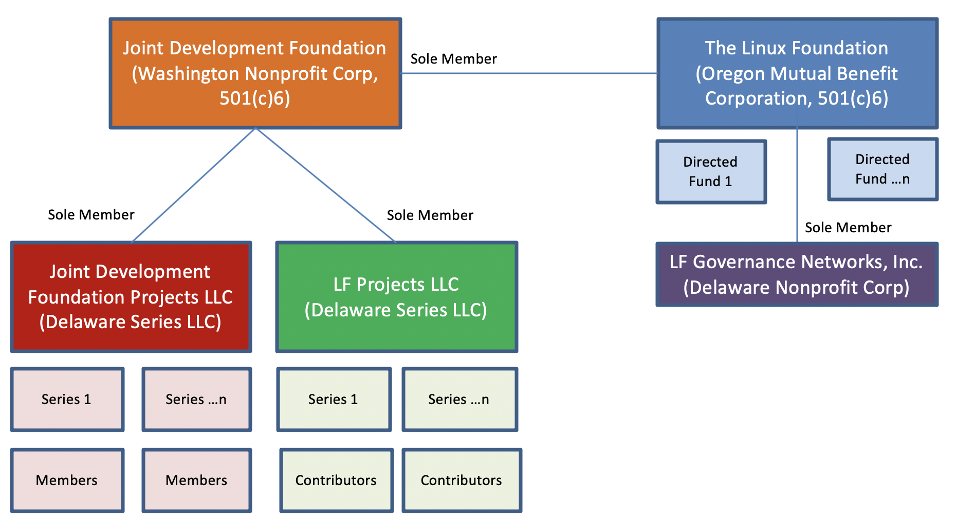

Linux Foundation: Legal Entity Structure
The LF provides a proven and reproducible organizational structure for a variety of open source projects.
Consortium Fund
is a
is a
is a
is a
Technical Project
Utility Project

Slide 24
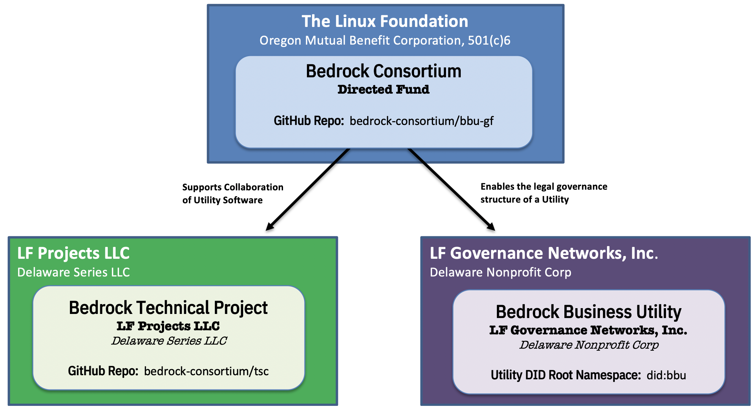
Members
Governance Framework
Bedrock Business Utility
The BBU operates as a Linux Foundation LF Governance Networks, Inc. (a Delaware Nonprofit Corp) under its own governance framework.
Bedrock Consortium: Represent a collection of international private sector companies and other organizations that operate and manage the Utility. A directed fund of the Linux Foundation (“LF”), serves the purpose of raising, budgeting and spending funds in support of the Utility and the Technical Project.
Bedrock Business Utility: A public identity utility supported by the LF Governance Networks, Inc. (a Delaware non-profit corporation). This non-profit corp serves as a signatory by executing the various agreements relating to the management of, or transacting with, the Utility.
Bedrock Technical Project: The Technical Project is established as the Bedrock Technical Project a Series of LF Projects, LLC with the mission of supporting the technical needs of the Bedrock Business Utility. Note: This Project will leverage other external open source projects where necessary.
Contributors
Issuers
Verifiers
Holders

Slide 25
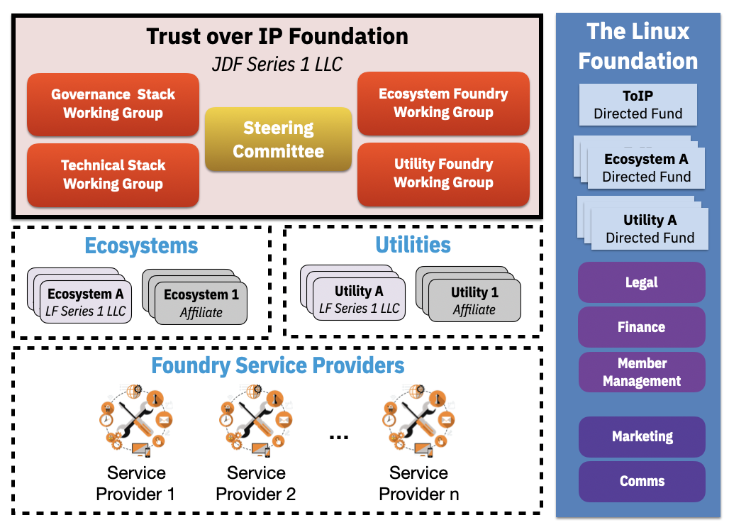
ToIP Foundation Affiliation
The BBU operates as a Linux Foundation LF Governance Networks, Inc. (a Delaware Nonprofit Corp) under its own governance framework.
The ToIP Foundation provides an open source collaborative community for the technologies and services necessary to establish, operate, maintain and govern digital trust ecosystems and associated utilities.
The Bedrock Consortium is an instance of an organization that will contribute to and leverage ToIP guidance.

Slide 26
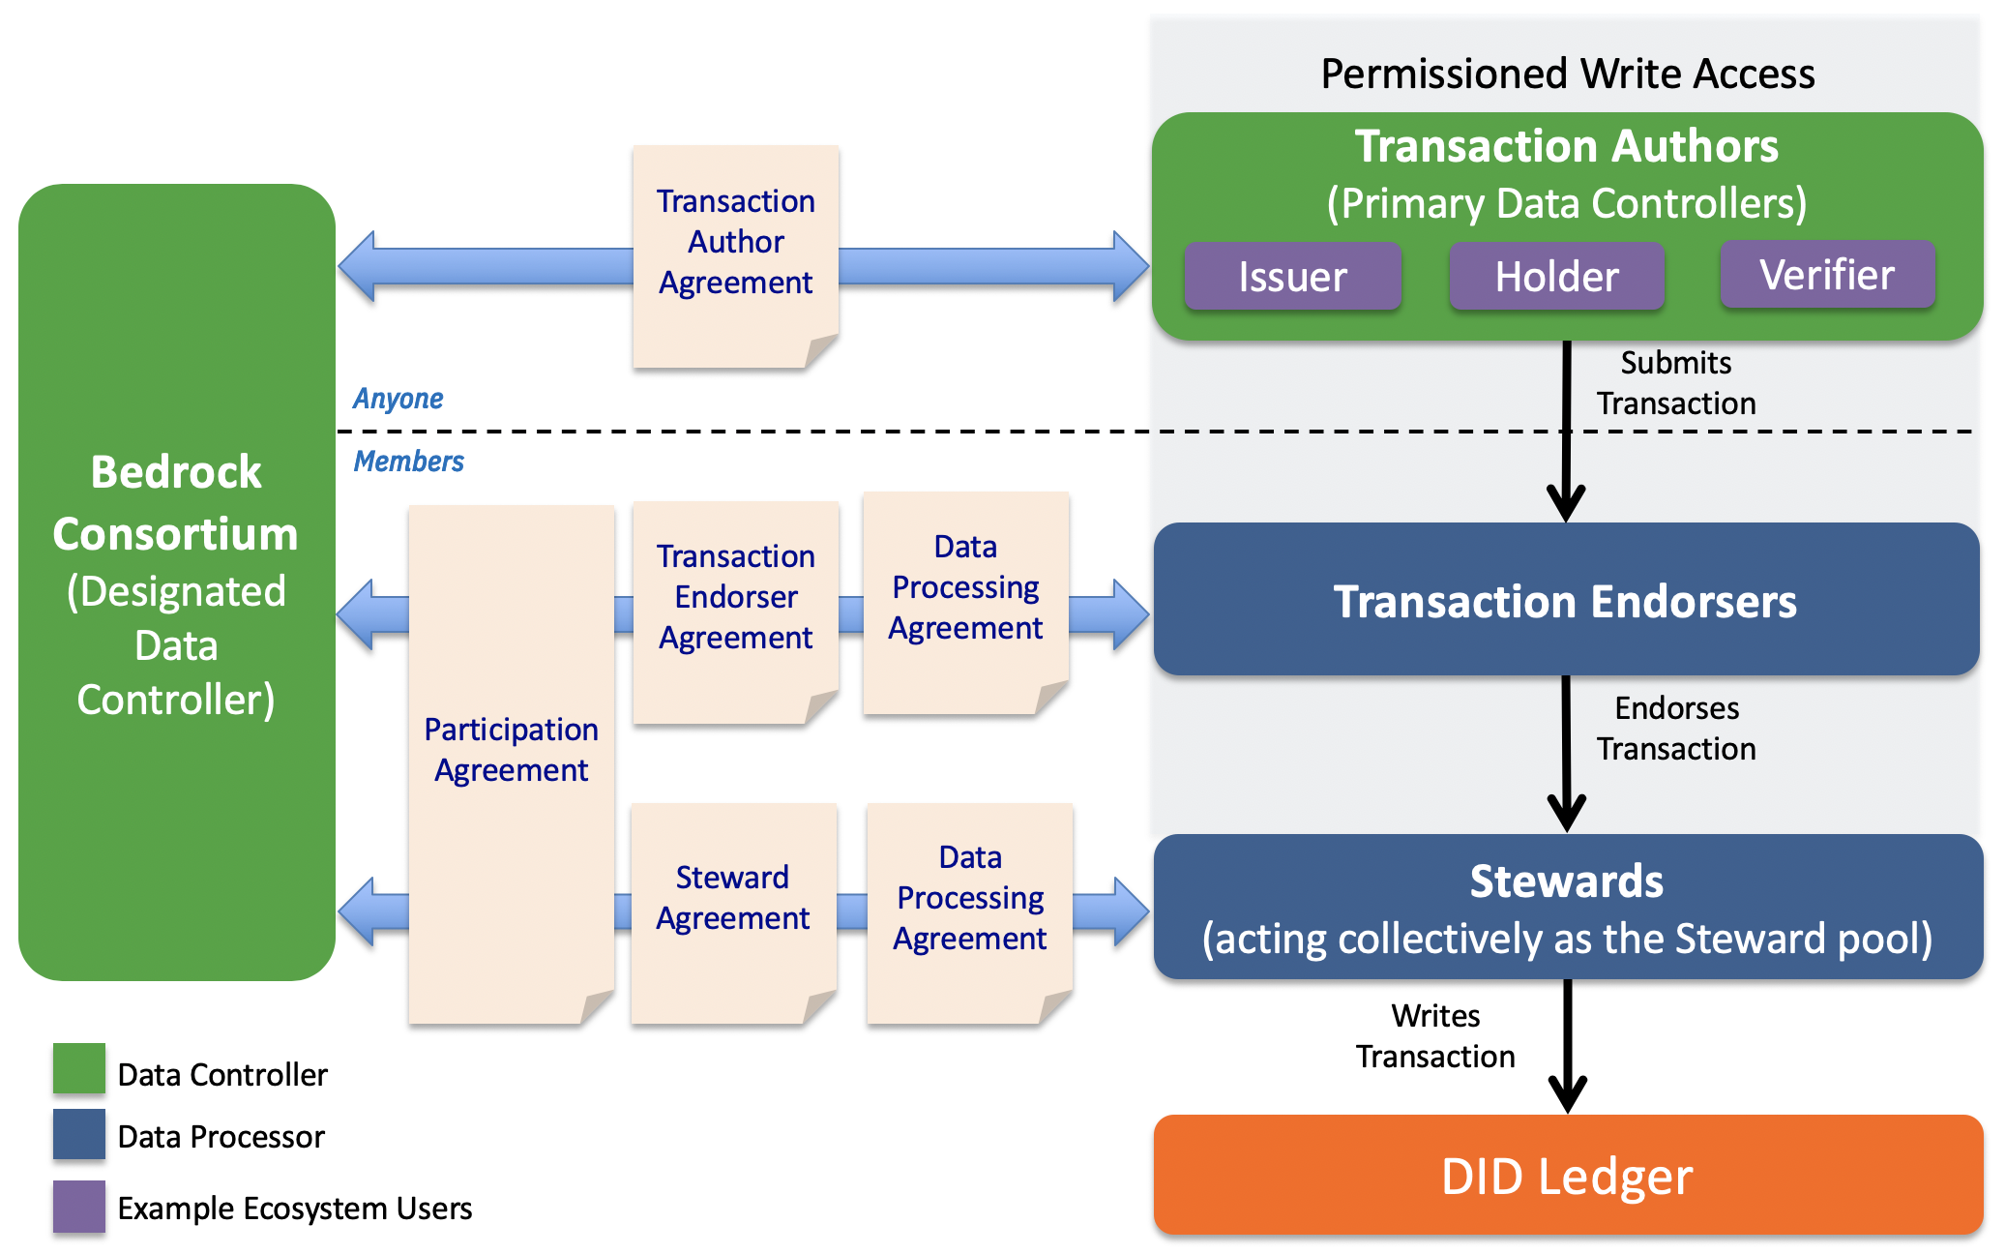
Bedrock Business Utility: Contractual Instruments
A dedicated decentralized identity utility for trusted commerce that is a safe-zone for enterprises.

Slide 27
Key BBU Concepts
What is the BBU business model?
What are the BBU access policies?
What membership types are available?

Slide 28
Business Model
Self-sustainability is a key BBU principle.
Members and/or Donors
Governance Framework
Version 0.9
Online: http://bbu.bedrockconsortium.org/
Income
Annual Membership Fees
Members receive transaction entitlements that they can monetize
Expenses
Ledger Operations and Maintenance is outsourced to a Utility Service Provider.
Identity Utility
Bedrock
Transaction Authors
Governing Body
Utility
Service Provider

Slide 29
Business Model
There are several factors that need to be considered with respect to a sustainable business model.
 | Node Hosting | Utility O&M Services | Membership Revenue | Transaction Revenue
Concept | A single centralized entity can not own and operate the ledger or the nodes attached to the ledger. | The management of a distributed ledger MUST be administered by skilled personnel. | Read transactions are generally publicly accessible and free, write transactions are typically fee-based. | The governing body of a public identity utility may charge fees for write access.
BBU Perspective | Some members are required to host nodes and are responsible for the financial demands of such hosting. | The Governing Board will will hire personnel responsible for the operation and maintenance of the Utility. | Write transactions are entitlements of membership. | The BBU does not collect revenue from transaction fees.Transaction Endorsers are free to charge any fee they desire for access to their write transaction entitlements.

Slide 30
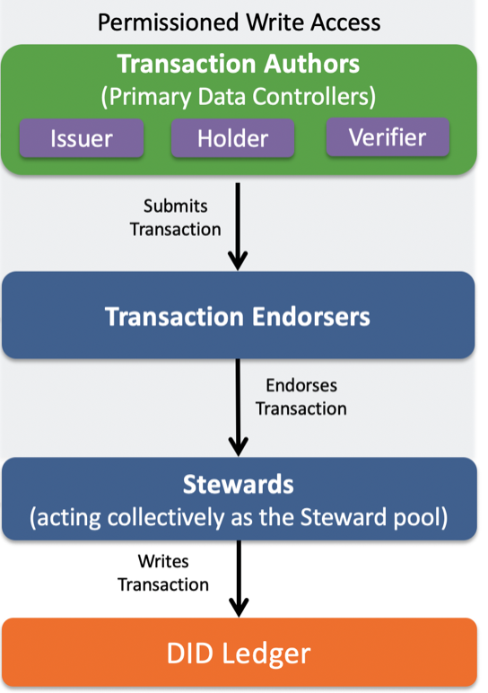
Ledger Access Policies
Permissioned access is a key BBU principle.
Permissioned Writes via Membership Entitlements
Transaction Authors submit write requests
Transaction Endorsers must approve all write requests
Stewards process write requests
Read access is available to the public

Slide 31
Membership
Entities can join and renew membership on an annual basis under three possible membership types.
 | Governing Member | Operational Member | Subscriber
Roles | Steward Tranaction Endorser Transaction Author (Optional) | Steward Tranaction Endorser Transaction Author (Optional) | Tranaction Endorser Transaction Author (Optional)
Obligations | Must host 1 utility infrastructure node. Must sign the required Utility Agreements. Must assign appropriately skilled resources that will meet the required time commitments for each of the governing bodies and the Technical Project. This includes, future additional governing bodies. | Must host 1 utility infrastructure node. Must sign the required Utility Agreements. Must assign appropriately skilled resources that will meet the required time commitments for at least one Directed Fund Committee and the Technical Project. | Must sign the required Utility Agreements.
Entitlements | A single representative on the Governing Board. Appointment of representatives to any Committee within the Directed Fund. Approval to act as a Transaction Endorser. Write Transactions as a Transaction Endorser | Appointment of representatives to any Committee within the Directed Fund. Approval to act as a Transaction Endorser. Write Transactions as a Transaction Endorser | Appointment of representatives to any Committee within the Directed Fund. Approval to act as a Transaction Endorser. Write Transactions as a Transaction Endorser

Slide 32
Membership
Participants in the Bedrock Consortium, a LF Directed Fund, must sign a set of Utility Agreements upon entrance and annual renewal. These agreements are in addition to the require Participation Agreement.
Utility Agreement | Governing Member | Operational Member | Subscriber Member
Steward Agreement | Required | Required
Steward Data Processing Agreement | Required | Required
Transaction Endorser Agreement | Required | Required | Required
Transaction Endorser Data Processing Agreement | Required | Required | Required
Transaction Author Agreement | Optional | Optional | Optional

Slide 33
Transaction Authors
As a public utility the BBU is available for free read transactions in support of identity verification processing. Write access is restricted to the role of a Transaction Author for both members and non-members.
Any entity that is the submitter of a write transaction in support of using the ledger for decentralized identity interactions.
Interacts with a Transaction Endorser for the processing of write requests.
Must adhere to submitting transaction types outlined in ledger access and ledger data policies.
Must sign the Transaction Author Agreement.
Identity Utility
Bedrock
Governing Body
Transaction Authors

Slide 34
Organizational Structure
What is the governing body?
What committees are available?

Slide 35
Membership Committee
Governing Bodies
Governing Board
Finance Committee
Each legal entity is assigned a governing body.
Marcom Committee
Governance Framework WG
Directed Fund
Governing Board
Membership Committee
Finance Committee
Marcom Committee
Governance Framework Working Group
Technical Project
Steering Committee (TSC)
Technical Steering Committee (TSC)

Slide 36
Participation
Why join?
How to join?

Slide 37
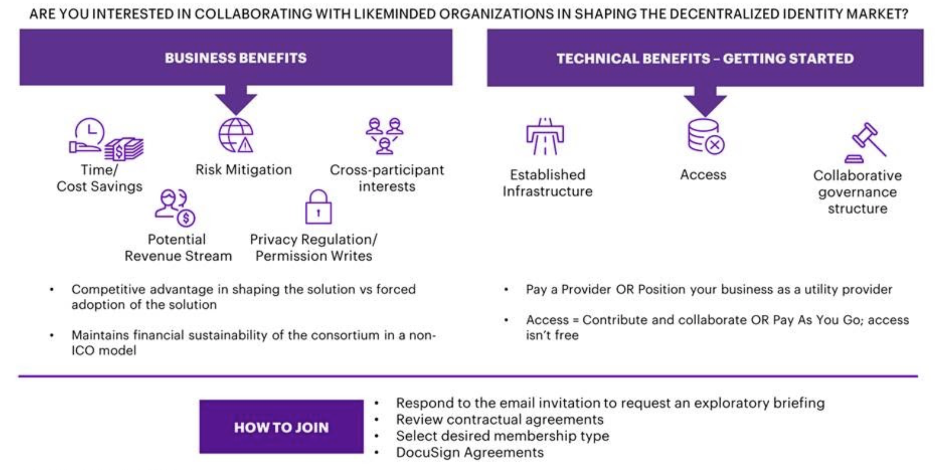
Benefits of Membership

Slide 38
Dependencies
Linux Foundation Membership is a pre-requisite for membership into BBU.
LF Platinum: $500,000
LF Gold: $100,000
LF Silver:
Under 100 employees: $5,000; 100-499 employees: $10,000; 500-4,999 employees: $15,000; 5,000 or more employees: $20,000.
LF Associate membership is available for non-profit, open source, and government entities at no cost.

Slide 39
Membership
Membership Class | Annual Membership Fees | Node Hosting Requirement | Write Transaction Entitlements
Governing Member | $15000 | 1 | Unlimited
Operational Member | $25000 | 1 | Unlimited
Subscriber Member | $40000 | 0 | 50
Associate Member | $0 | 0 | 0
Linux Foundation onboarding process allows for simple DocSign activation.
Join LF, if not an existing member.
Select Membership Class and sign required agreements:
Participation Agreement
Utility Agreements
Pay invoice
NOTE: Prospective Members receive First Right of Refusal on Governing Membership up to a certain date.
Pricing based on Wave 2 estimates of 36 Stewards.
Subscriber membership comes with 50 transaction entitlements per annual membership. Additional transactions can be acquired per annum @ $10K / 50.
While a Subscriber may purchase an unlimited number of entitlement packages, all unused transactions expire at years end without rollover.

Slide 40


Membership: Obligation Example
As our population increases, membership fees decrease. Initial goal is to launch with 36 Stewards.
Participation obligations include resources (people and compute) plus membership fees.
Assumptions
OOP Node-aaS Cost (annual) | $65,000
OOP Endorser-aaS Cost (annual) | $2,000
Baseline Membership Fees | Wave 1 | Wave 2 | Wave 3 | Wave 4 | Wave 5
Governing | $25,000 | $15,000 | $15,000 | $15,000 | $10,000
Operational | $35,000 | $25,000 | $20,000 | $20,000 | $20,000
Subscriber | $40,000 | $40,000 | $40,000 | $40,000 | $40,000
 | Wave 1 |  |  | Wave 2
Governance Structure | Governing | Operational | Steward Pool | Governing | Operational | Steward Pool
Membership Allocations | 7 | 18 | 25 | 9 | 27 | 36
BoD to Steward Ratio | 28% |  |  | 25%
Annual Member OOP Costs (cash only) | $92,000 | $102,000 |  | $82,000 | $97,000
Mandatory Resource Commitments | 1 Per WG | 2 |  | 1 Per WG | 2
Out-of-Pocket costs include:
Node Hosting
Endorser Hosting
Annual Membership
Resource commitments pertain to WG participation and are based on Membership Type:
Governing: 4 or more
Operational: 2
Hosting Options
3rd Party Provider
Self-managed BAF Deployment

Slide 41
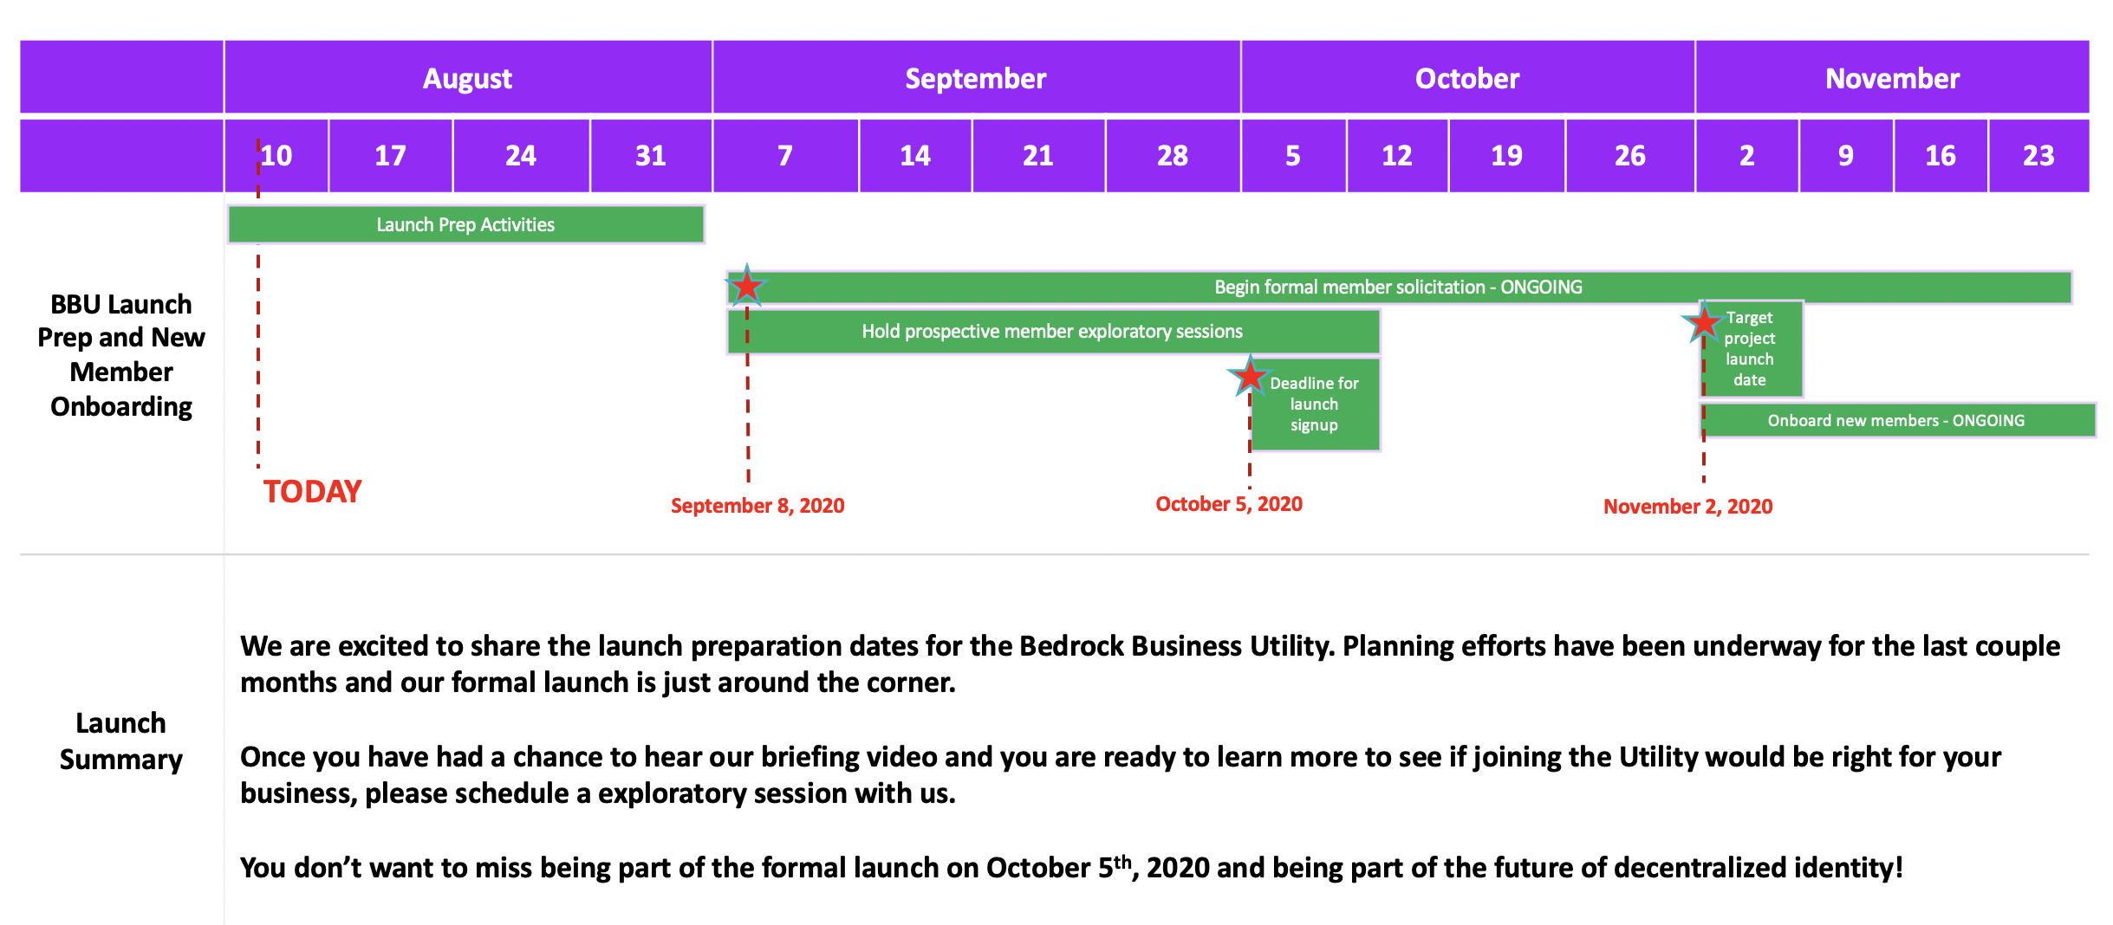
Project Launch - Plan of Record

Slide 42

Thank you
Related resources:
linuxfoundation.org
trustoverip.org
bedrockconsortium.org
Bedrock GitHub Repo
Bedrock Governance Framework

